Slide 1



Data-Driven Storytelling Presentation: Account Sales Analysis

Slide 2
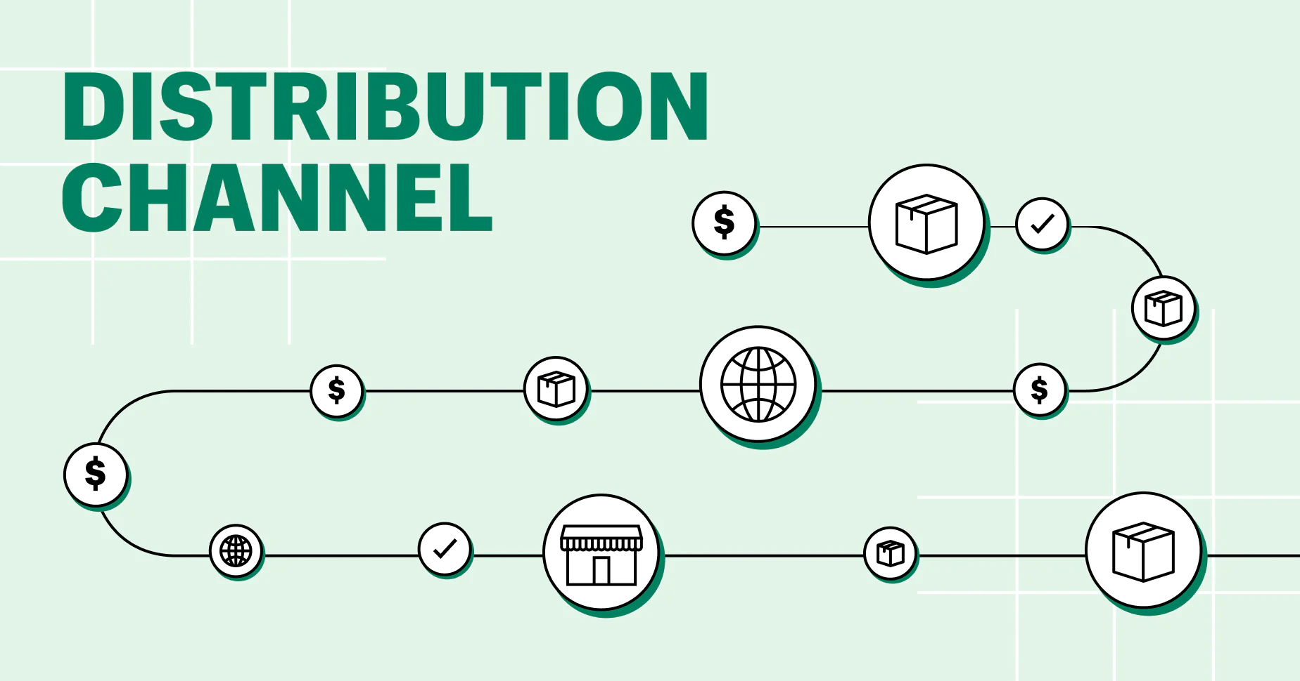
Small Business
Whole-Sale
Online Retail
Medium Business

Slide 3
Key point, observation or data here…
The Unit sales of all accounts for years 2017, 2018, 2019, 2020, and 2021. There is progression seen in all the top 10 accounts.
All Accounts including the top 10 have all been approached with various marketing techniques or promotion programs e.g. Social Media, Coupons, Catalog Inclusion, and Posters.
The 5 year CAGR(Compound annual growth rate) has also shown progression.
The top 10 Accounts in CAGR Tim Young accounts show the highest progression in CAGR.
The sales may be lower but by not neglecting the 5-year CAGR makes the highest progressive accounts in the future.
By the Analysis of the accounts there is no imbalance or favoritism on types of accounts.

Slide 4
Key point, observation or data here…

Slide 5
Key point, observation or data here…

Slide 6
Key point, observation or data here…
The Top 10 accounts by CAGR are Tim Young, Bill Callahan, Raymond Heywin, Carlos Jackson, Mel Berkowitz, Anthony Brooks, Craig Collins, Larry Alaimo, Arnell Straughter, and Dominique Johnson.
Over the years the sales have increased and throughout the sales analysis, it also shows that almost all accounts and sales sectors are making progress.
In the Marketing / Promotion Programs there are people more attracted to online retail. As day by day use of technology in public hands has been increasing rapidly.
Also account approvals and consent as giving a ‘yes’ for posters have shown a big jump and seem to be more favorable for people to have for sales.

Slide 7
Summary
The Final summary of the Given Data on Account Sales Analysis.
The Companies who have a linear or rapid progression should keep the same strategies intact.
The rest Accounts who have a very imbalance or instability in their accounting sales should try online retail and posters.
Finally accounting sales have progressed over the years.
The 5-year CAGR(Compound annual growth rate) has also shown progression in the top 10 accounts.

